Slide 1
Restaurant Customer Management Database
Warren Huang
Instructor: Lakisha Brooks
Laney College CIS 98

Slide 2
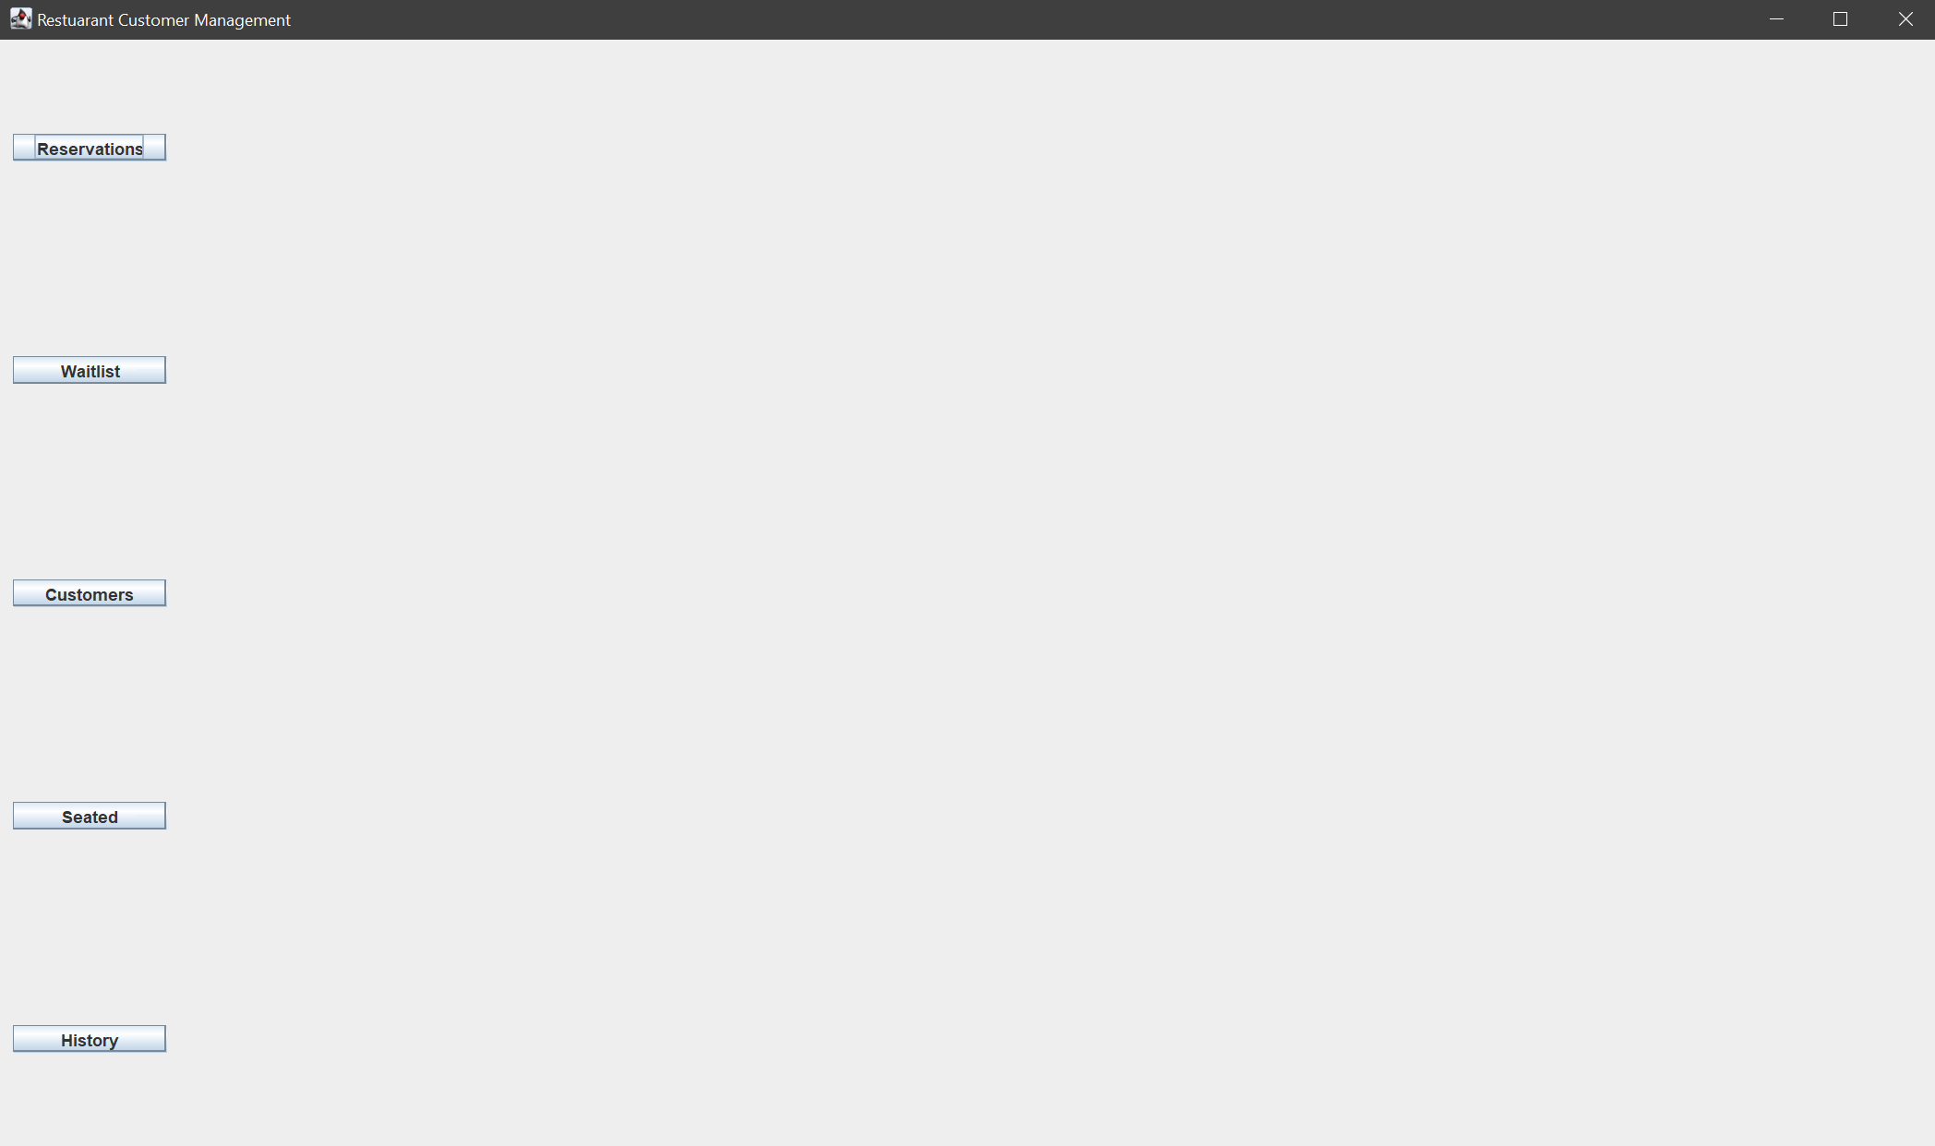
A simple GUI designed at JAVA Swing based

Slide 3
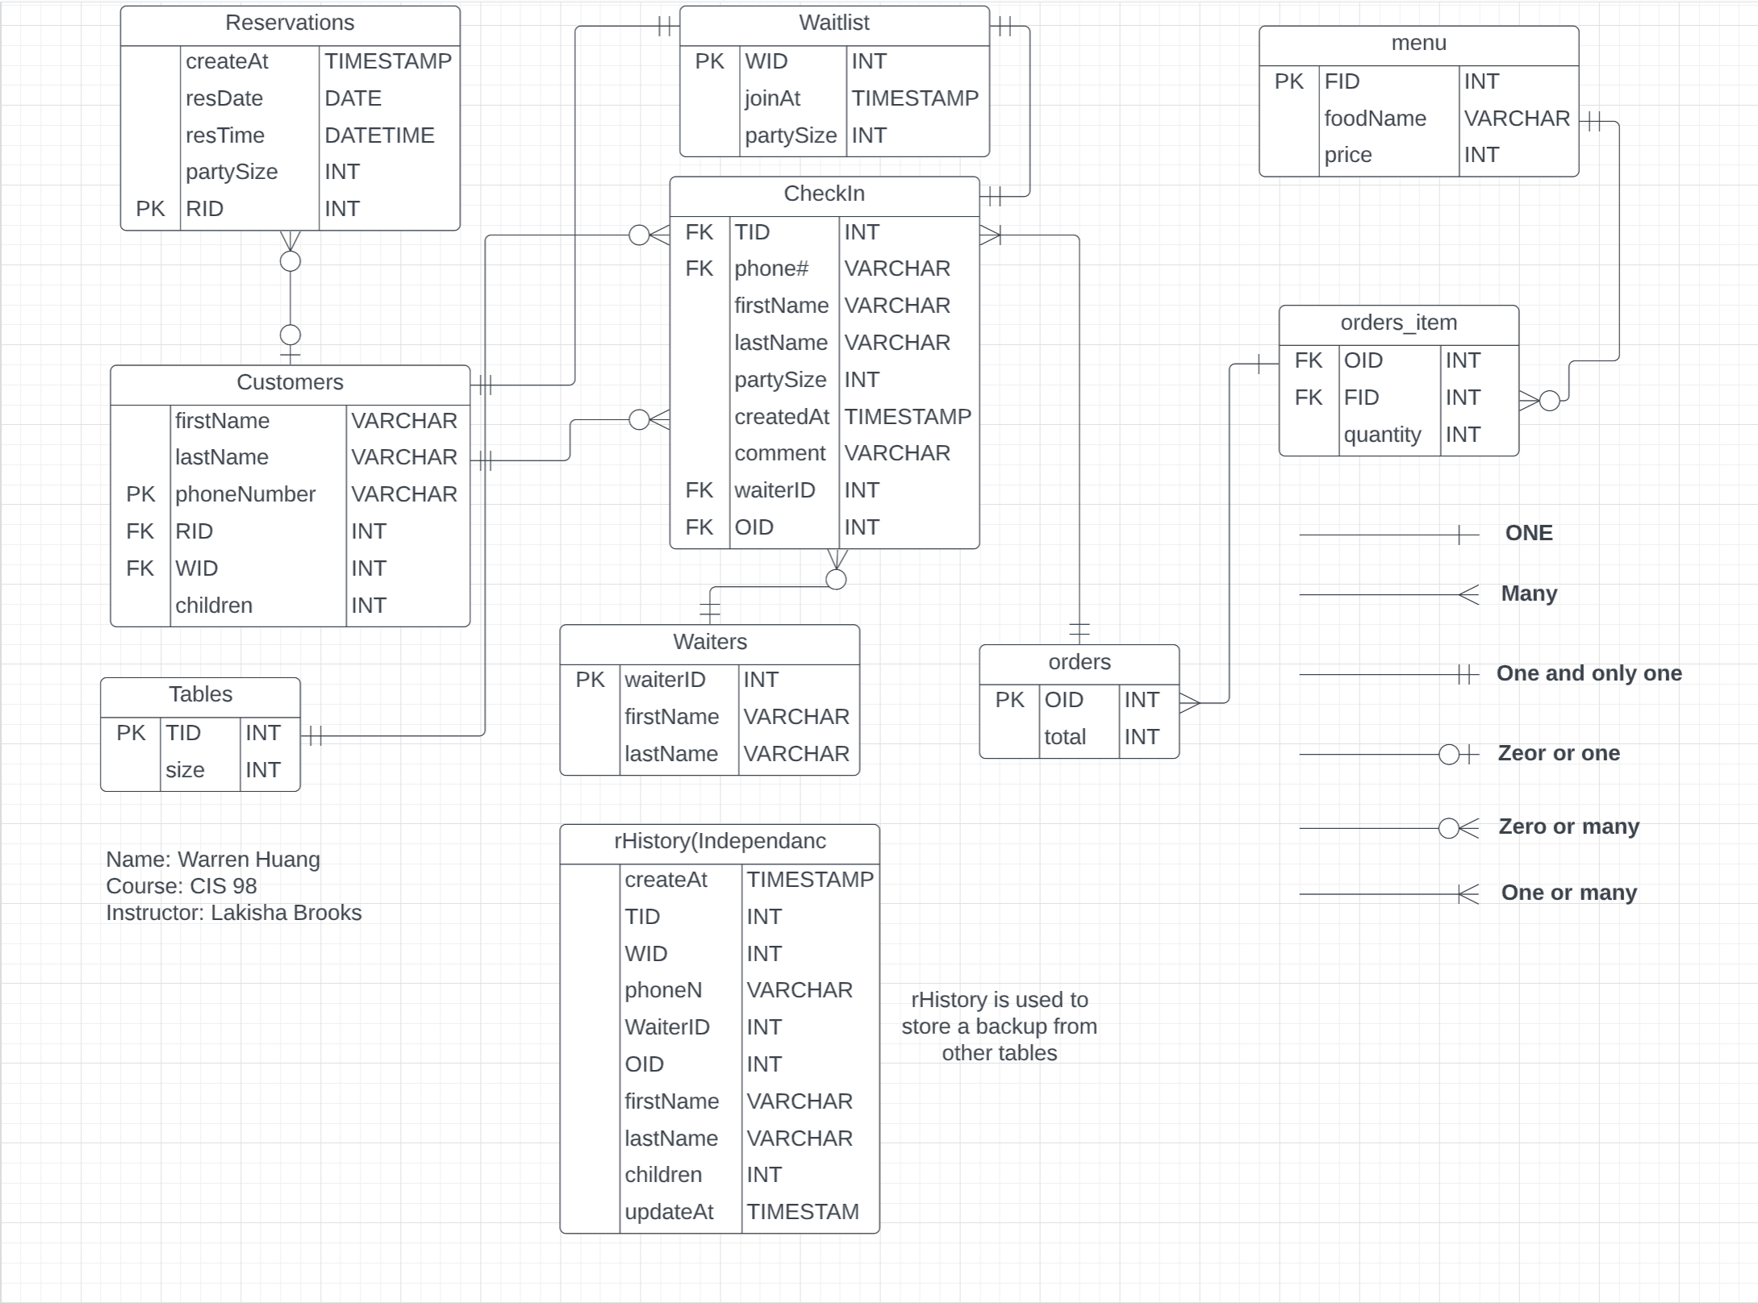
Entity Relationship Diagram
(ERD)

Slide 4
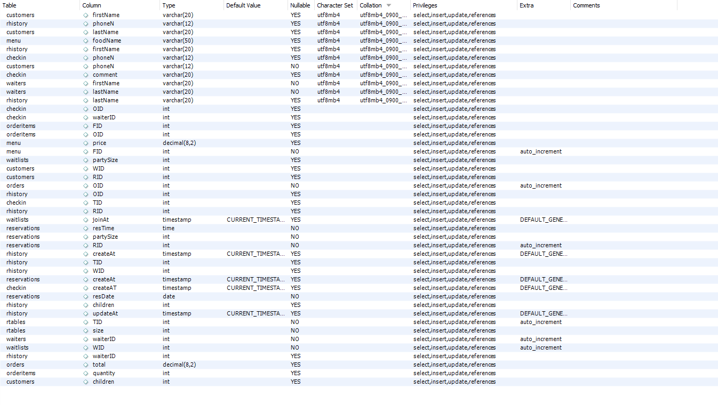
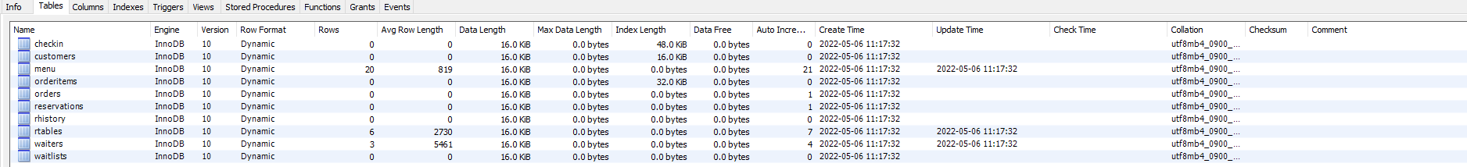
Schema

Slide 5
UID
RID(Reservation ID)
WID(Waitlist ID)
TID(Table ID)
PhoneN(Phone Number)
FID(Food ID)
Waiter ID
OID(Order ID)
RID is unique in reservation table
WID is unique in waitlist table
TID is unique in “table” table
PhoneN is unique in customer table
FID is unique in menu table
Waiter ID is unique in waiter table
OID is unique in order table
Above contents are all auto_increment
Each table has at least ONE constraint from/to others UID
Except “rhistory” table, which is information backup purpose

Slide 6
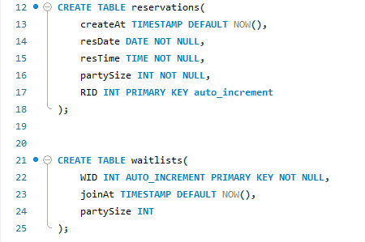
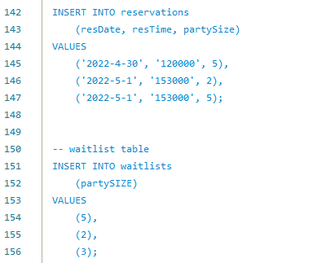
How it works?
The “Reservations” and “Waitlist” tables hold initial specified detail along with RID or WID
Next, RID or WID will be assigned to
“customers” table to be bounded

Slide 7
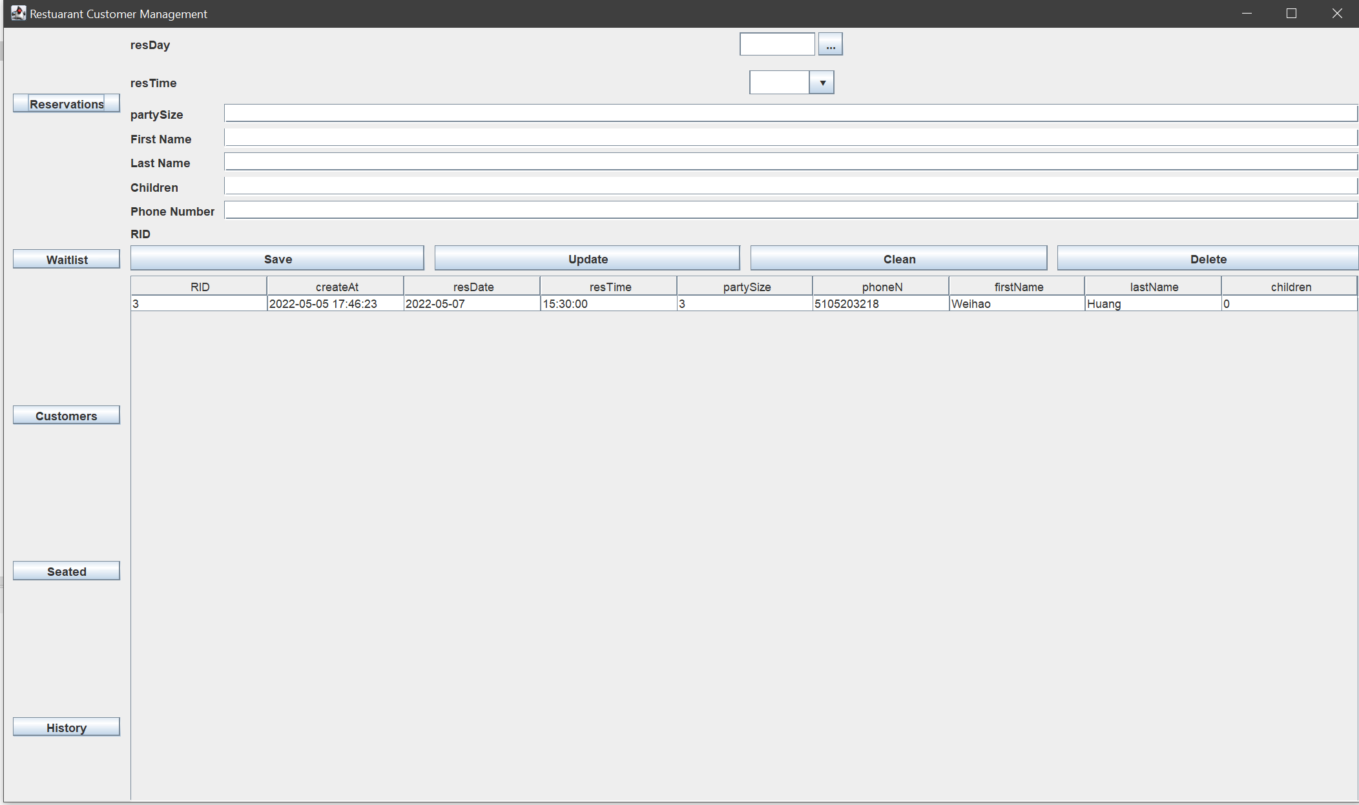
Example(Reservations Interface)
The parts handled by “reservations” table
Query:
INSERT INTO reservations
(resDay, resTime)
VALUES
(?,?);
The pars handled by
“customers” table
Query:
INSERT INTO
Customers
(firstName, lastName
Childre, PhoneN)
VALUES
(?,?,?,?)
Retrieve data from “reservations” table and “customer” table
Query:
SELECT
RID, createAt, resTime, resDate, partySize, firstName, lastName, children
FROM
reservations
LEFT JOIN customers USING(RID) ;

Slide 8
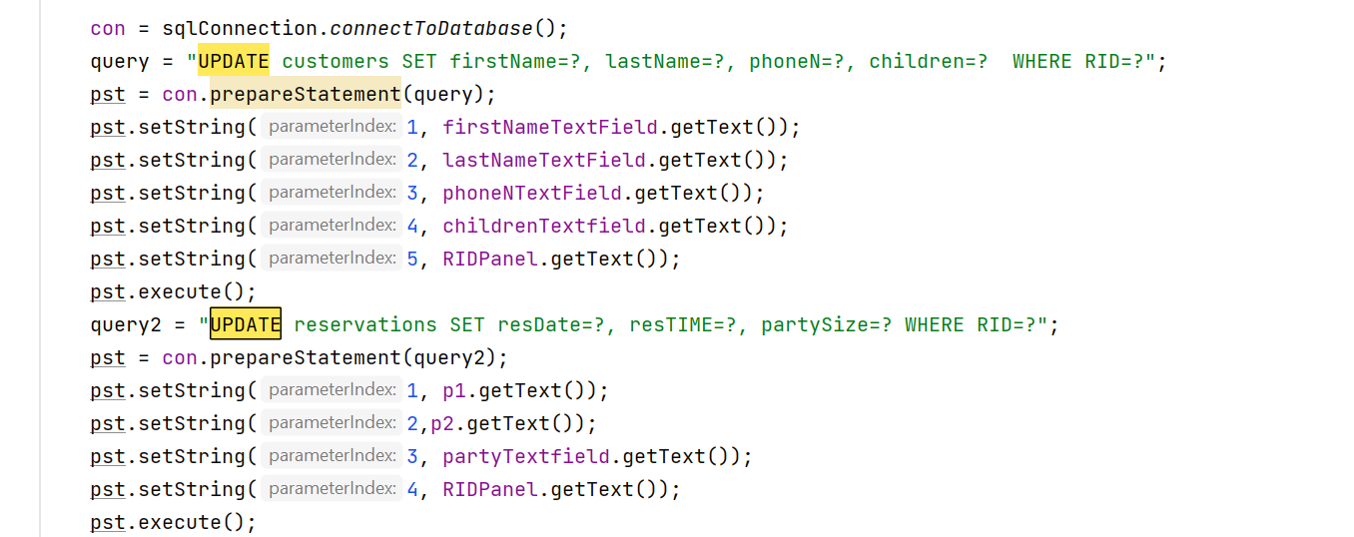
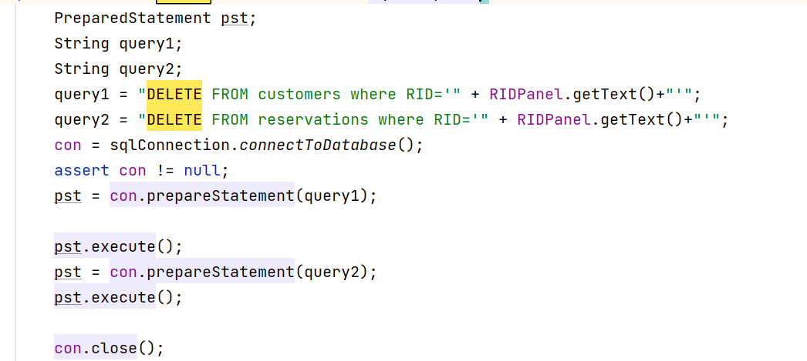
Features in Reservations(CRUD)
Create: Create date to tables
Read: Read data from tables
Update: Update data to tables
Delete: Delete data to tables
UPDATE reservations
SET
resDAY = ?,
resTime = ?
partySize = ?
WHERE RID = ?
DELETE FROM reservations
WHERE RID = ?
*Above is syntax implementing in JAVA, SQL query is written in GREEN

Slide 9
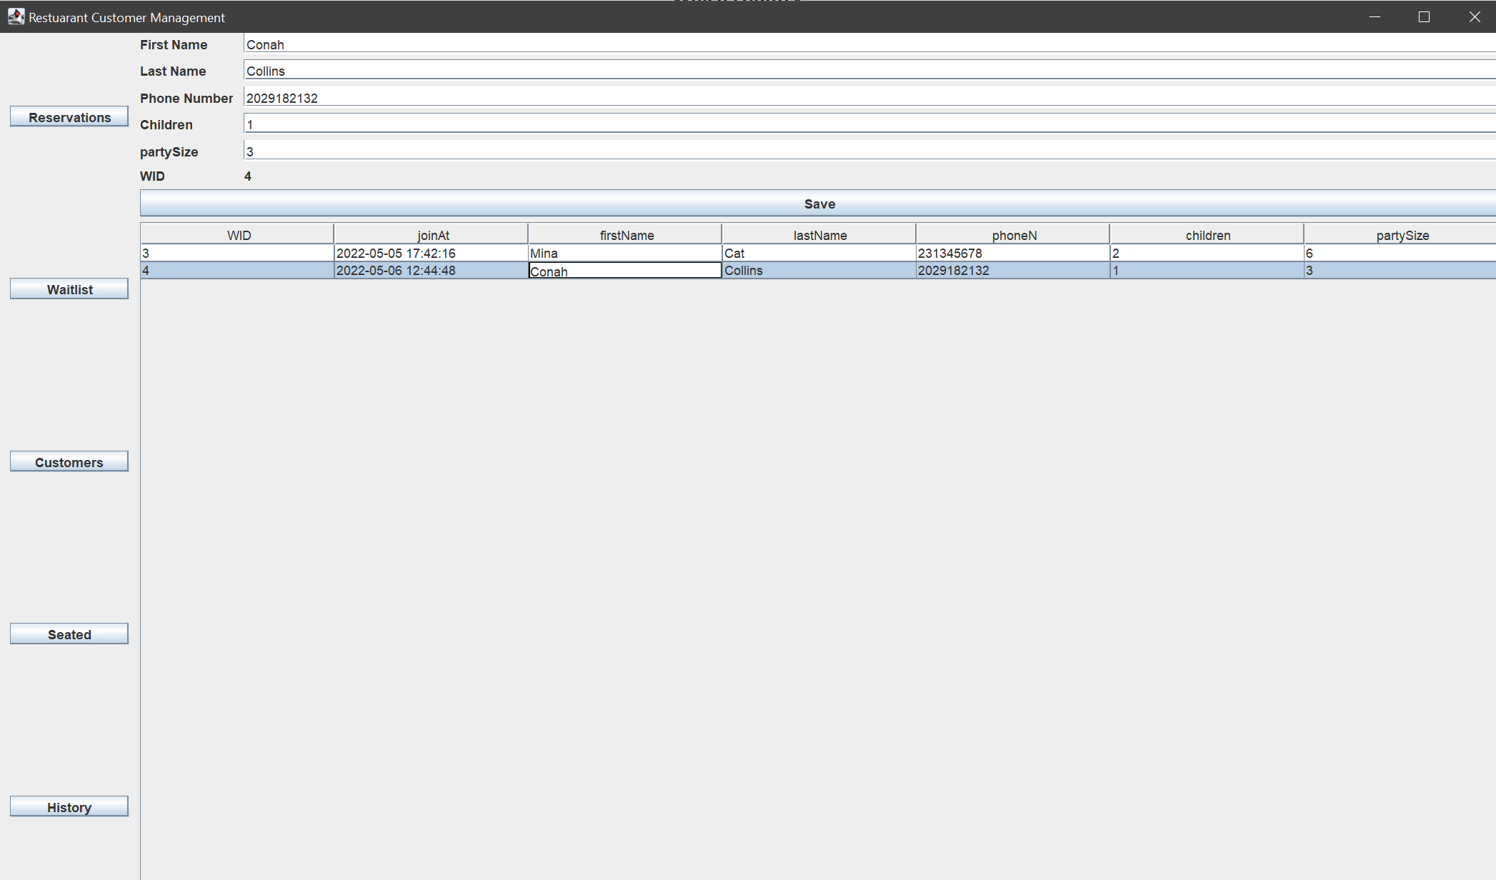
Example(Waitlist Interface)
Query: SELECT
*
FROM waitlist
LEFT JOIN customers USING(WID)

Slide 10
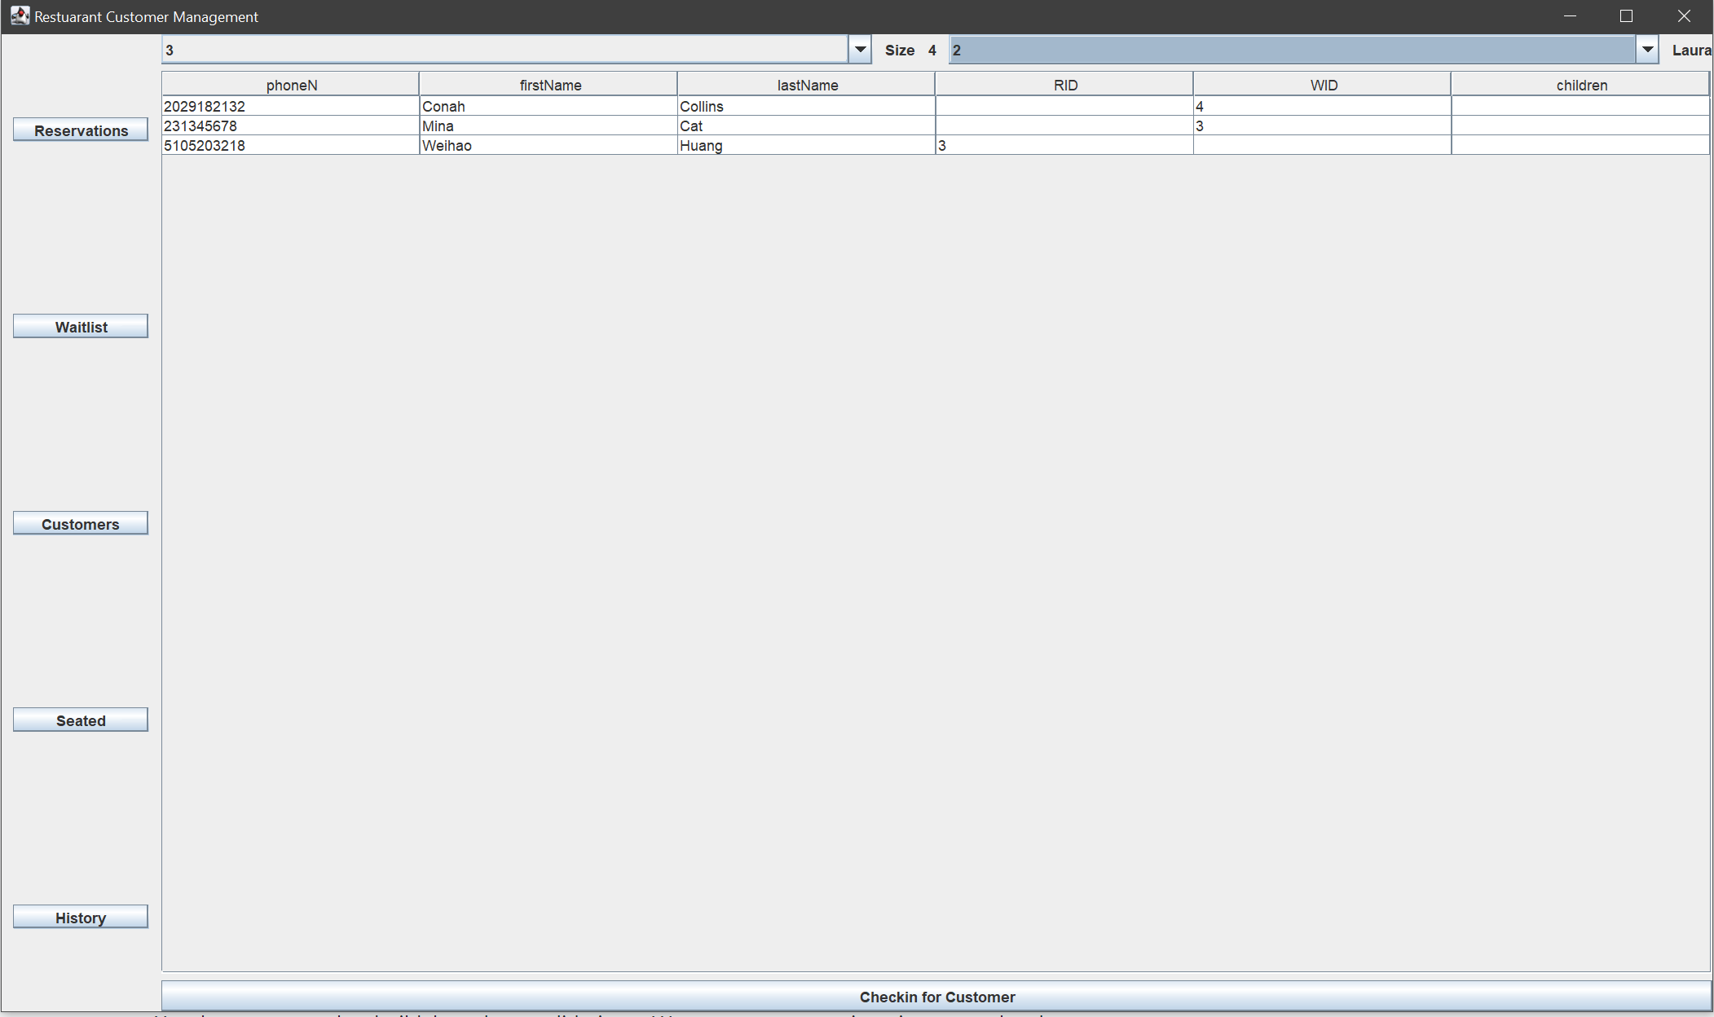
All data from customer's table
Getting data from “rtable” table and “waiter” table:
SLECT TID
FROM rtable
LEFT JOIN checkin USING(TID)
WHERE checkin.TID IS NULL;
(*Table will be out of the list when it is used)
SELECT waiterID FROM waiters;
Query:
SELECT * FROM customers
Insert customer information, TID, waiterID to “checkin” table:
INSERT INTO checkin(TID, phoneN, waiterID) VALUES (?,?,?);

Slide 11
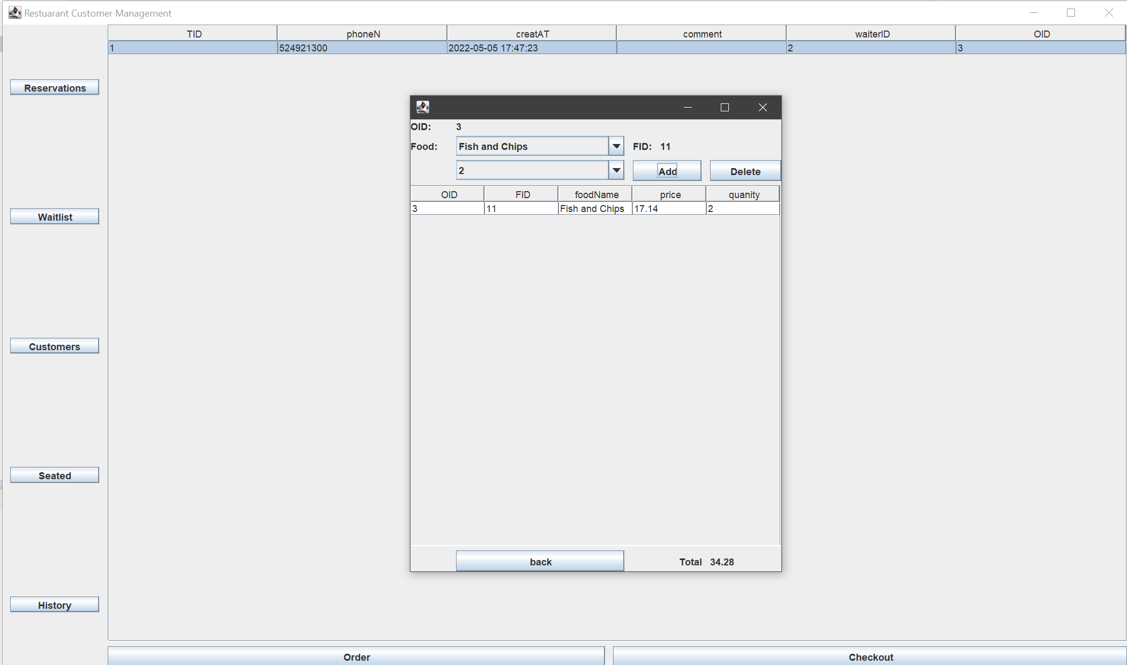
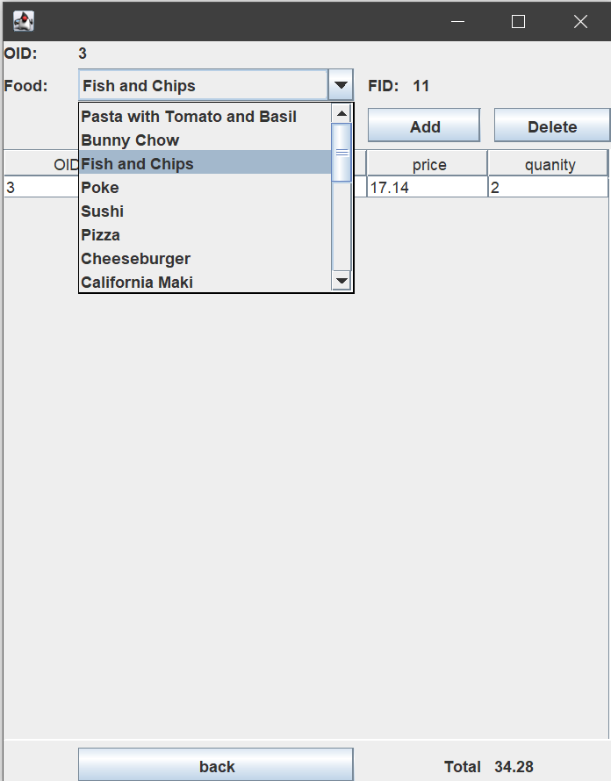
Menu, orderitems, and orders
“Menu” table: takes care of the foodName and FID
“Orderitems” table: takes care of all items with assigned OID
“Orders” table: collects OID and constrains to “checkin” tables

Slide 12
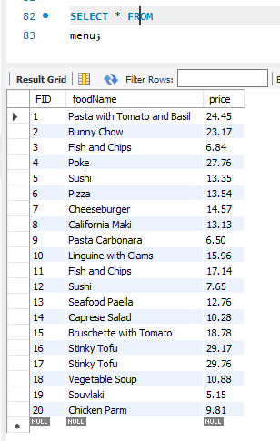
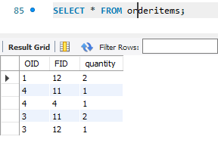
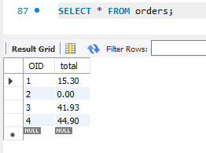
HOW it works?
Calculate a total price?
QUERY:
SELECT
SUM(price * quantity)
FROM oders
JOIN orderitems USING(OID)
JOIN MENU USING(FID)
WHERE OID = ?
GROUP BY OID;
menu table
Orderitems table
Orders table
After total calculation, update the total into “orders” table
Query:
UPDATE orders
SET total = ?
WHERE OID = ?
* “orders” table created OID auto_increment and total = 0 by default

Slide 13
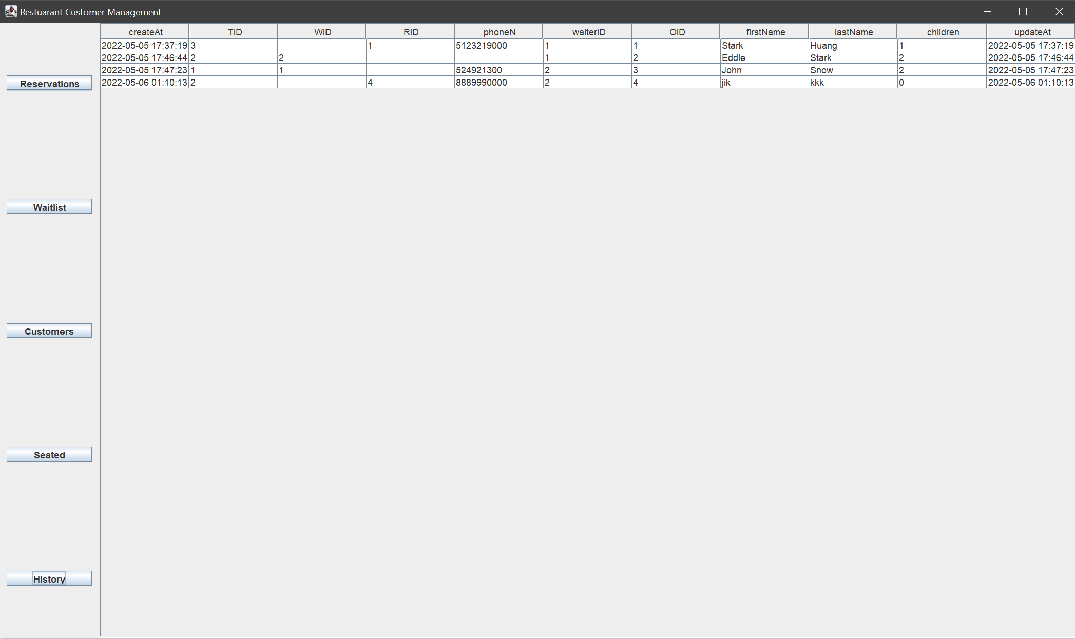
How history table works?
The “history” table is an independent table used to store all backup information, and update/insert from “customers” JOIN “checkin” table.(Table to table implementation)
Core Query:
I INSERT INTO rhistory
OID,firstName, lastName, children, phoneN, RID, WID, TID, waiterID
SELECT
OID, firstName, lastname, children, phoneN, RID, WID, TID, waiterID
FROM
customers
RIGHT JOIN checkin USING(phoneN)
WHERE customers.phoneN = ?"

Slide 14
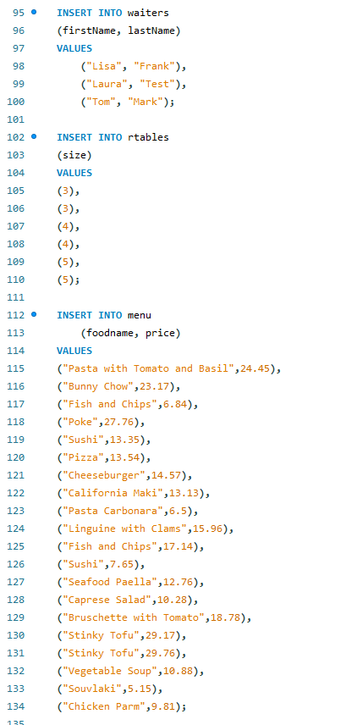
Supplements
“waiters”, “rtables” and “menu” tables’ data is generated when the Restaurant database is created

Slide 15
Thank you

